Slide 1

Counter-powers and political pluralism

Slide 2
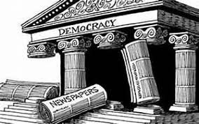
Definition of counter-power
Counter-power is a power, which organizes itself against an established authority.
It can be a political, economic or social force and its role has the effect of restricting the exercise of power in place and providing an alternative to the decisions of an authority.
Ex: elected representatives of an opposition party, associations and in particular trade unions, the media, religious officials etc.

Slide 3
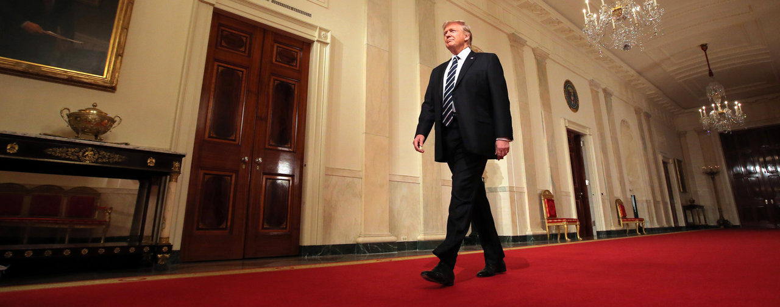
The example of Donald Trump
Can you name some forms of counter-power about Donald Trump’s policy?

Slide 4



The example of Donald Trump
Justice: judges speak out against anti-immigration decrees; civil rights organizations
Media: newspapers as «Washington Post» and «New York Times»
Demonstrations: mobilizations on environment, male chauvinism
Big companies: Silicon Valley
Democrats and some Republicans: debates at the Congress

Slide 5
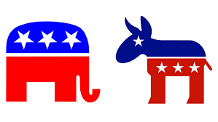
Political Pluralism
The principle that recognizes and guarantees the expression and representation of the diversity of political opinions, and in particular their institutional and partisan representation (i.e. multi-party system).
Thus, the principle of pluralism must or should be translated into the media space.
Ex: in France, CSA is in charge of verifying that all political currents can express themselves on the TV or on the radio.

Slide 6
Pluralism
Could you name countries that do not apply political pluralism?

Slide 7







The European Commission's support for the production of this publication does not constitute an endorsement of the contents, which reflect the views only of the authors, and the Commission cannot be held responsible for any use which may be made of the information contained therein.
This work is licensed under a Creative Commons Attribution 4.0 International License.

